Slide 1
Introduction to LLM (Large Language Model) Applications on AMD Platforms
黃彥勲
Sean Huang
Notes:
在AMD平台打造您的大型語言模型(LLM)應用

Slide 2

Lesson Outline
Theoretical Component:
Foundations of LLMs
Basics of LLM Fine Tuning
Retrieval-Augmented Generation (RAG)
Practical Component:
Porting Nvidia Solutions to ROCm/Ryzen AI
Preparations for Working With LLMs
LLM Deployment Using Transformers
LLM Deployment Alternatives
RAG Using Ollama and LM Studio
Fine Tuning with LoRA
Omitted Content:
Introduction to Function Calling: Overview
Function Calling Implementation
Speculative Decoding
Code and lecture slides: https://github.com/jonathansimple/intro-to-llms
Notes:
24.10

Slide 3
Overview
Introduction
This course serves as an introductory guide for those interested in learning about LLMs for the first time or those deploying LLM solutions on ROCm. It covers a high level discussion on the foundation of LLMs and includes practical implementations attendees can follow along.
Target Audience
Programmers familiar with Python
Computer Science or Electrical Engineering students interested in building LLM solutions on ROCm
Anyone looking to build their first LLM project
Developers looking to migrate CUDA solutions to AMD platforms
Resources
Code and lecture slides: https://github.com/jonathansimple/intro-to-llms
Notes:
Beginner friendly course

Slide 4
Foundations of LLMs

Slide 5
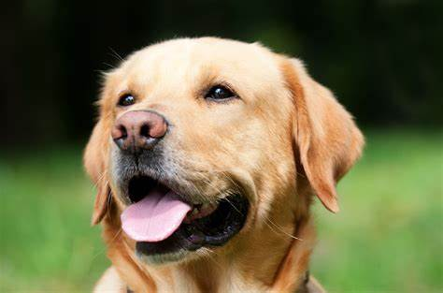
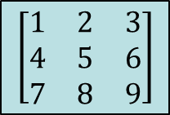
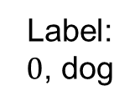
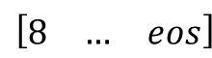
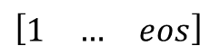
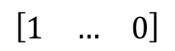
Comparison With CNN
CNN steps: convert image to matrix → inference → f(output)
Function f can be argmax for classification, for example
LLM steps: tokenize (string to token) → inference (generate) → decode (token to string)
Tokenization example:
"ChatGPT is amazing!" → ['Chat', 'G', 'PT', ' is', ' amazing', '!’] → [12345, 678, 91011, 314, 56789, 42]
cv2
$$\left[\begin{matrix}1 & 2 & 3 \\ 4 & 5 & 6 \\ 7 & 8 & 9\end{matrix}\right]$$
matmul
CNN
argmax
$$\left[\begin{matrix}1 & 2 & 3 \\ 4 & 5 & 6 \\ 7 & 8 & 9\end{matrix}\right]$$
Label: $0$, dog
$$\left[\begin{matrix}1 & 2 & 3 \\ 4 & 5 & 6 \\ 7 & 8 & 9\end{matrix}\right]$$
$$\left[\begin{matrix}1 & … & 0\end{matrix}\right]$$
Image
augmentation
tokenize
matmul
LLM
decode
“How are you?”
$$\left[\begin{matrix}1 & … & eos\end{matrix}\right]$$
$$\left[\begin{matrix}8 & … & eos\end{matrix}\right]$$
“I’m doing great”

Slide 6
Background For LLMs: Tokenizer
What are tokens?
LLMs need tokenizers to convert strings into tokens (numerical IDs) that the model can understand
Working with numerical values (float/int) is easier than strings
Every model has their own tokenizer
To better generalize unseen vocabulary during training, words are broken down into smaller parts (so one word can be more than one token)
Word seen during training: “unavailable”
“un” → 42
“avail” → 189
“able” → 76
New unknown word seen during inference: “unimaginable”
“un” → 42
“imagine” → ?
“able” → 76
Token 42 = not/opposite
Token 76 = can
So “unimaginable” should have a meaning related to being unable to do something
Notes:
Tokenizer set during training; if you use a tokenizer for one model on a different model, the output will break

Slide 7
What LLMs Are Out There?
GPT, Deepseek, Llama, gemma, Taide, Breeze, Mistral, Internvl, Qwen…
Each model has their own strengths and weaknesses:
GPT: most well rounded option out there, but not open source and not commercially hostable
Breeze: has Traditional Chinese support + open source + commercially viable (3B, 8B); output can be a bit verbose
More and more recent models are capable of function calling – it’s all about picking what suits your use case best (model size, multi-lingual support, etc.)
Newer models have better text comprehension and some models that weren’t trained to do function calling can still perform basic FC if taught in prompts
Why do we need fine tuning then?
Stability, formatting, some smaller models really don’t have one-shot learning capability because they can’t generalize well enough

Slide 8
Basics of LLM Fine Tuning

Slide 9
Fine Tuning Methods
Most common methods:
Full fine tuning
LoRA

Slide 10


Full Fine Tuning
Like the name suggests, this updates all model parameters during training
Pros:
Cons:
Best performance when trying to train a model for a specific task
Modifies core model behavior (reasoning, output format)
Used to create foundational models
Very demanding resource wise (time, VRAM, checkpoint storage, data required)
Easy to overfit on small datasets and forget old skills

Slide 11
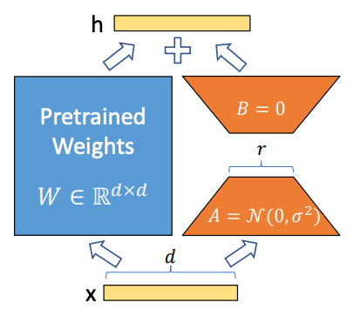
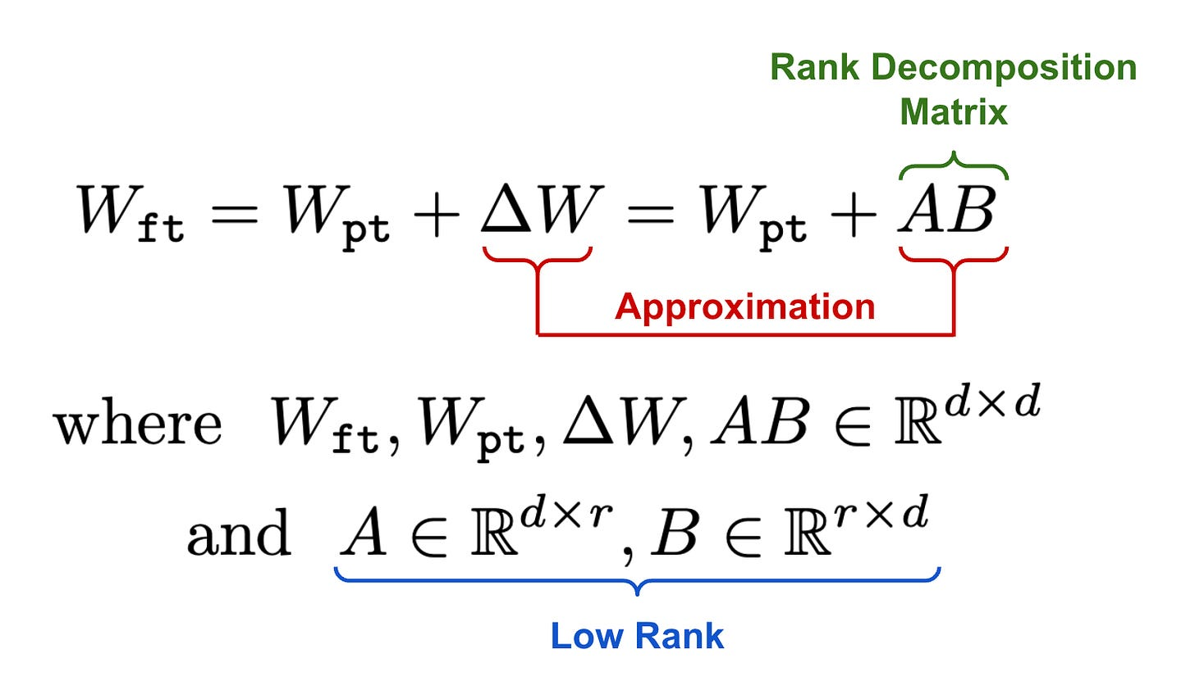
Low-Rank Adaptation (LoRA)
How It Works:
Freeze the pre-trained LLM weights.
Add small trainable low-rank matrices (A & B) to attention layers.
Train only these new matrices, keeping the original model intact.
The trainable weights are then merged with the base model.
As a simple illustration, a d=100 dimension yields a 10,000 parameter layer, with r = 16, the total LoRA trainable parameters is 3,200, a 68% decrease in parameters
Notes:
initialize A with random, small values, while B is initialized as zero, ensuring that we begin the finetuning process with the model’s original, pretrained weights

Slide 12
Low-Rank Adaptation (LoRA)
Key Benefits:
✅ Reduces Memory Usage – Fine-tunes only a small fraction of the model parameters. ✅ Faster Training – Requires fewer computations, making it cost-efficient. ✅ Retains Pre-Trained Knowledge – Keeps most of the original model weights frozen. ✅ Easier Adaptation – Fine-tune large models (e.g., LLaMA, Mistral) on consumer GPUs. ✅ No Added Inference Latency – doesn’t slow down model.
Use Cases:
Fine-tuning LLMs on domain-specific data (e.g., medical, legal, finance) and special formatting
Fine tuning on limited hardware
When you only want to partially modify model performance while maintaining core behavior

Slide 13
Retrieval-Augmented Generation (RAG)

Slide 14
What Is RAG (Retrieval-Augmented Generation)?
Problem: LLMs like GPT are trained on massive datasets, but they:
Can hallucinate (make up facts)
Do not have any knowledge of current events after their training cutoff date
Can’t access private or custom data during pretraining
For smaller models, they lack domain specific expertise
Solution: RAG
Step 1: Retrieve relevant documents from an external database (e.g., PDFs, websites)
Step 2: Generate an answer using both the user question and the retrieved content
This makes responses:
✅ More accurate
✅ More up-to-date
✅ Customizable to your domain
All without fine-tuning!

Slide 15
RAG Encoder
How does the retrieval system know which documents are relevant?
With RAG, you are working (generally) with 2 models
LLM model (generator) that answers your questions
Embedding model (encoder) that maps your question into the same vector space as your dataset (vector store)
The vector store finds the most similar documents (top-k) to the query vector (cosine similarity)

Slide 16
An Example RAG Framework
Query
Output
……
LLM
……
Top k most relevant context (cosine)
encoder
----------
----------
----------
encoder
(offline)
Reference documents
Vector database

Slide 17
RAG At Work
If you use an older model like gemma-2-2b-it and ask it:
Do you have any information on who the president of the United States is in 2025?
It will respond with:
I do not have access to real-time information, including future events. Therefore, I cannot tell you who the President of the United States will be in 2025.
With RAG:
According to the news sources you provided, the President of the United States in 2025 would be **Donald Trump**.

Slide 18
When to Use RAG?
Most tasks can be accomplished with RAG (without fine tuning the model)
To draw a parallel with CNNs, RAG is similar to using data augmentation (prompt engineering) and few shot learning to circumvent fine tuning
Applications:
Domain specific QA: customer service, automatic inspection
Personalized service: can't be expected to load entire chat history or fine tune model for every user
Cheaply update model while maintaining model's core behavior

Slide 19
Practical Component: Porting Nvidia Solutions to ROCm/Ryzen AI

Slide 20
AMD Hardware and Driver Support
Two types of AMD hardware:
AI PCs (laptops) - Ryzen AI 300-series PCs with iGPU + NPU
Desktops – GPUs like RX 6800 and W6800 and up
What’s the difference?
Different hardware require different drivers:
AI PCs: NPU drivers + Ryzen AI Software
Desktops: ROCm (Linux), HIP SDK* (Windows)
*HIP (Heterogeneous-computing Interface for Portability) SDK for Windows brings a subset of the ROCm platform to Windows
Notes:
https://github.com/amd/RyzenAI-SW/blob/main/example/llm/lemonade/cpu/Llama_3_2_1B_Instruct.md
NPU drivers: https://ryzenai.docs.amd.com/en/latest/inst.html#install-npu-drivers
Rocm link: https://rocm.docs.amd.com/projects/install-on-linux/en/latest/install/quick-start.html
Windows rocm compatibility: https://rocm.docs.amd.com/projects/install-on-windows/en/latest/reference/system-requirements.html
Windows installation: https://rocm.docs.amd.com/projects/install-on-windows/en/latest/index.html#hip-install-quick

Slide 21
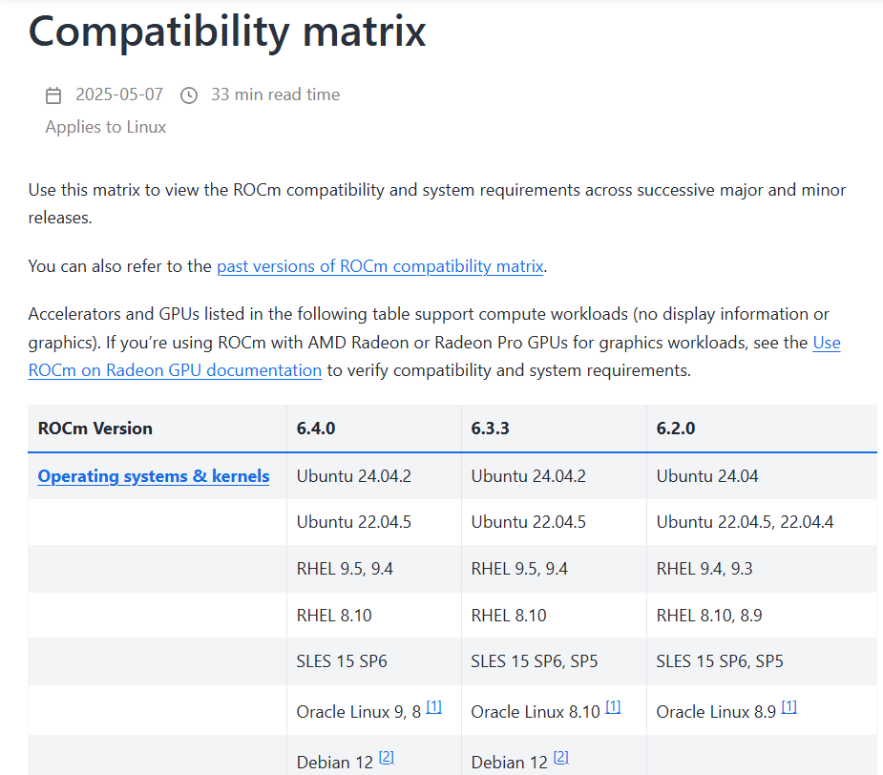
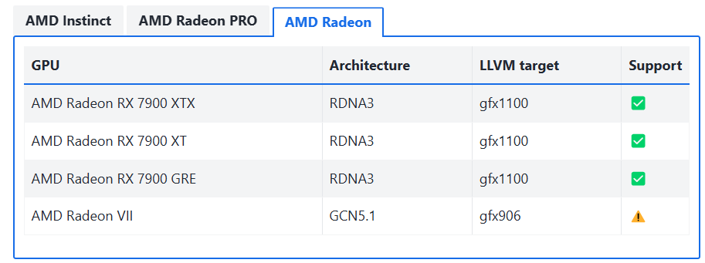
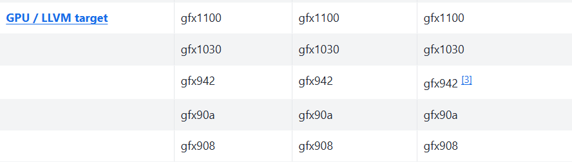
Determining Which ROCm Version Is For You
2.
Short answer: depends on your hardware
1. For which AMD GPUs supports which LLVM target, visit: https://rocm.docs.amd.com/projects/install-on-linux/en/latest/reference/system-requirements.html
2. For the full compatibility matrix, visit: https://rocm.docs.amd.com/en/latest/compatibility/compatibility-matrix.html
1.

Slide 22
ROCm Installation (Ubuntu 24.04)
Install ROCm
wget https://repo.radeon.com/amdgpu-install/6.4/ubuntu/noble/amdgpu-install_6.4.60400-1_all.deb
sudo apt install ./amdgpu-install_6.4.60400-1_all.deb
sudo apt update
sudo apt install python3-setuptools python3-wheel
sudo usermod -a -G render,video $LOGNAME # Add the current user to the render and video groups
sudo apt install rocm
Install AMD GPU drivers
wget https://repo.radeon.com/amdgpu-install/6.4/ubuntu/noble/amdgpu-install_6.4.60400-1_all.deb
sudo apt install ./amdgpu-install_6.4.60400-1_all.deb
sudo apt update
sudo apt install "linux-headers-$(uname -r)" "linux-modules-extra-$(uname -r)"
sudo apt install amdgpu-dkms
Information from:
https://rocm.docs.amd.com/projects/install-on-linux/en/latest/install/quick-start.html

Slide 23
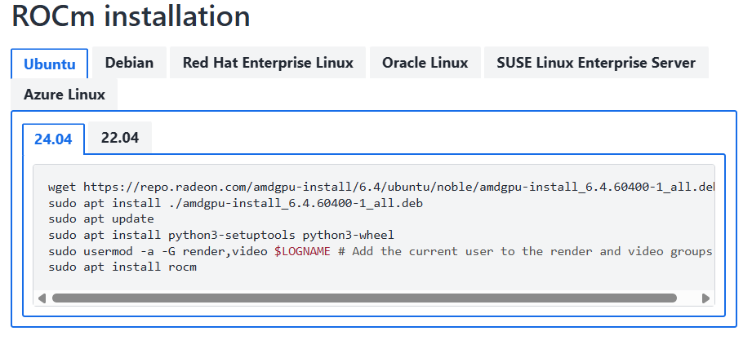
ROCm Installation for Different Distributions
Information from:
https://rocm.docs.amd.com/projects/install-on-linux/en/latest/install/quick-start.html

Slide 24
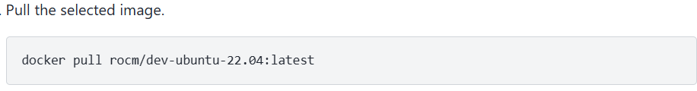
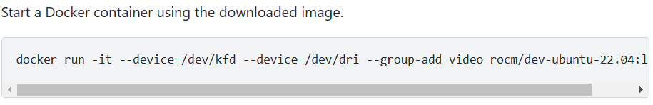
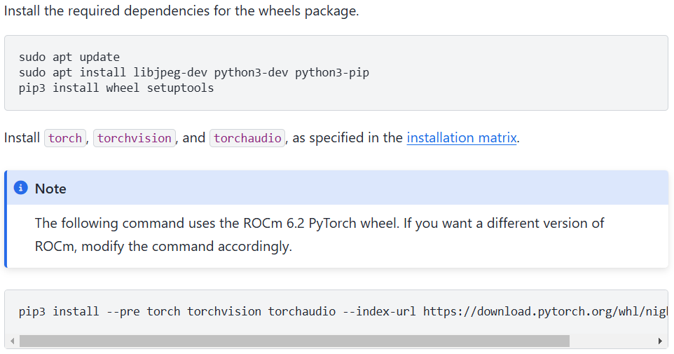
ROCm Pytorch Setup (Ubuntu 22.04)
Screenshots from: https://rocm.docs.amd.com/projects/install-on-linux/en/latest/install/3rd-party/pytorch-install.html
Python 3.10
--index-url https://download.pytorch.org/whl/nightly/rocm6.2/

Slide 25
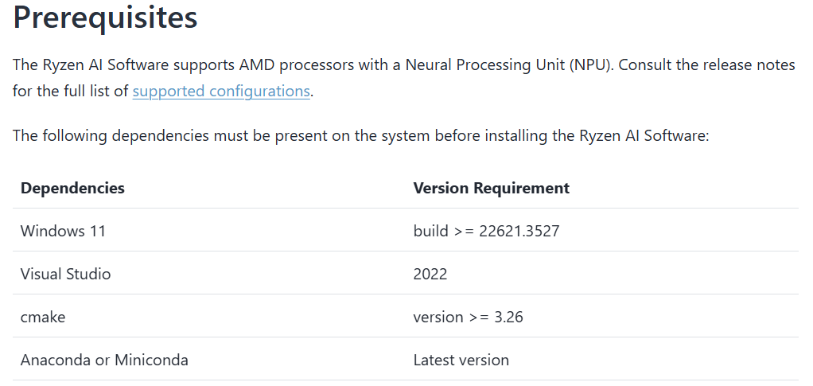
AI PC NPU Driver Installation (Windows)
Go to: https://ryzenai.docs.amd.com/en/latest/inst.html#install-npu-drivers
Ensure your system has the prerequisites installed
Notes:
https://ryzenai.docs.amd.com/en/latest/inst.html#install-npu-drivers

Slide 26
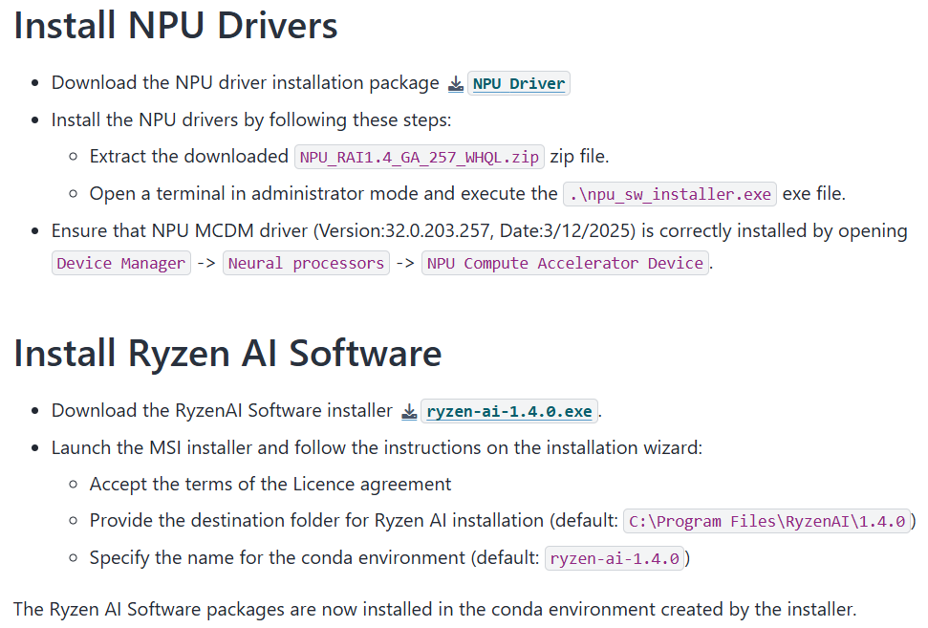
AI PC NPU Driver Installation (Windows)
Create an AMD account and download + run the installers (free)
Notes:
https://ryzenai.docs.amd.com/en/latest/inst.html#install-npu-drivers
Sample demo: https://github.com/amd/RyzenAI-SW/blob/main/example/llm/lemonade/hybrid/Llama_3_2_1B_Instruct.md

Slide 27
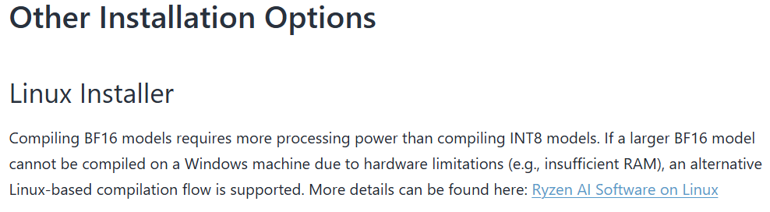
AI PC NPU Driver Installation (Linux)
A Linux installer can be found at the bottom of https://ryzenai.docs.amd.com/en/latest/inst.html
Notes:
https://ryzenai.docs.amd.com/en/latest/inst.html#install-npu-drivers
Sample demo: https://github.com/amd/RyzenAI-SW/blob/main/example/llm/lemonade/hybrid/Llama_3_2_1B_Instruct.md

Slide 28
Porting Nvidia-Based Solutions to ROCm
No code change needed
The only difference between a CUDA and a ROCm project is in its environment setup
Specifying devices:
CPU: “cpu”
GPU: “cuda”
For multi-GPU setups, device is specified using the same method: “0”, “0,1”, etc.

Slide 29
Porting Nvidia-Based Solutions to AI PCs
Minor code change needed
AI PCs rely on the onnx runtime to enable NPU acceleration, without it, speedup is limited
Projects with CPU-only fallback solutions do not need to be modified
When setting up this environment, I strongly recommend following AMD’s Ryzen AI Software + NPU driver installation (the Ryzen AI Software installer will set up a compatible conda environment for you)
Refer to this for an example of running onnx LLMs: https://github.com/amd/RyzenAI-SW/blob/main/example/llm/lemonade/hybrid/Llama_3_2_1B_Instruct.md

Slide 30
Preparations for Working With LLMs

Slide 31
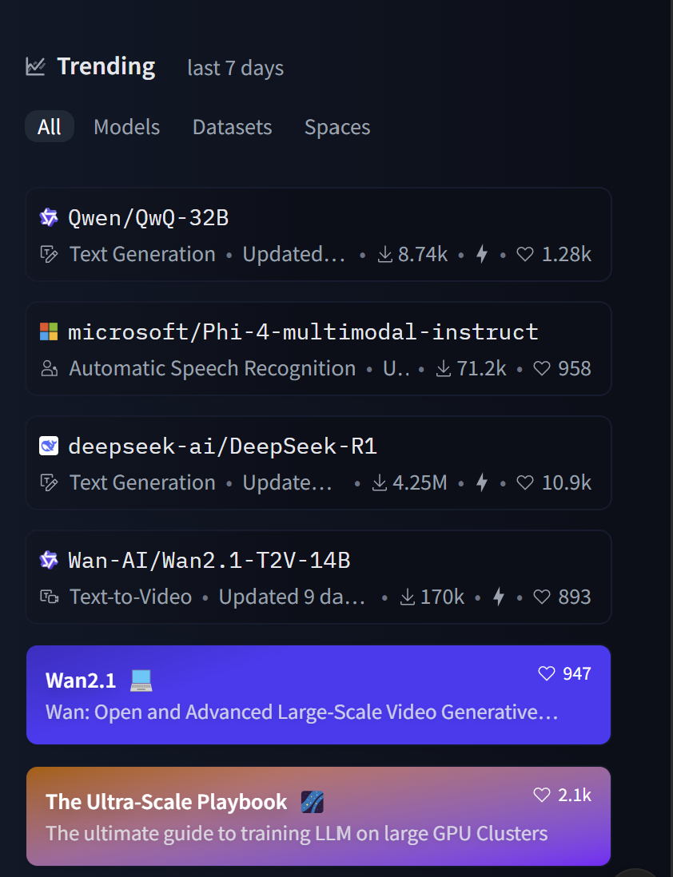
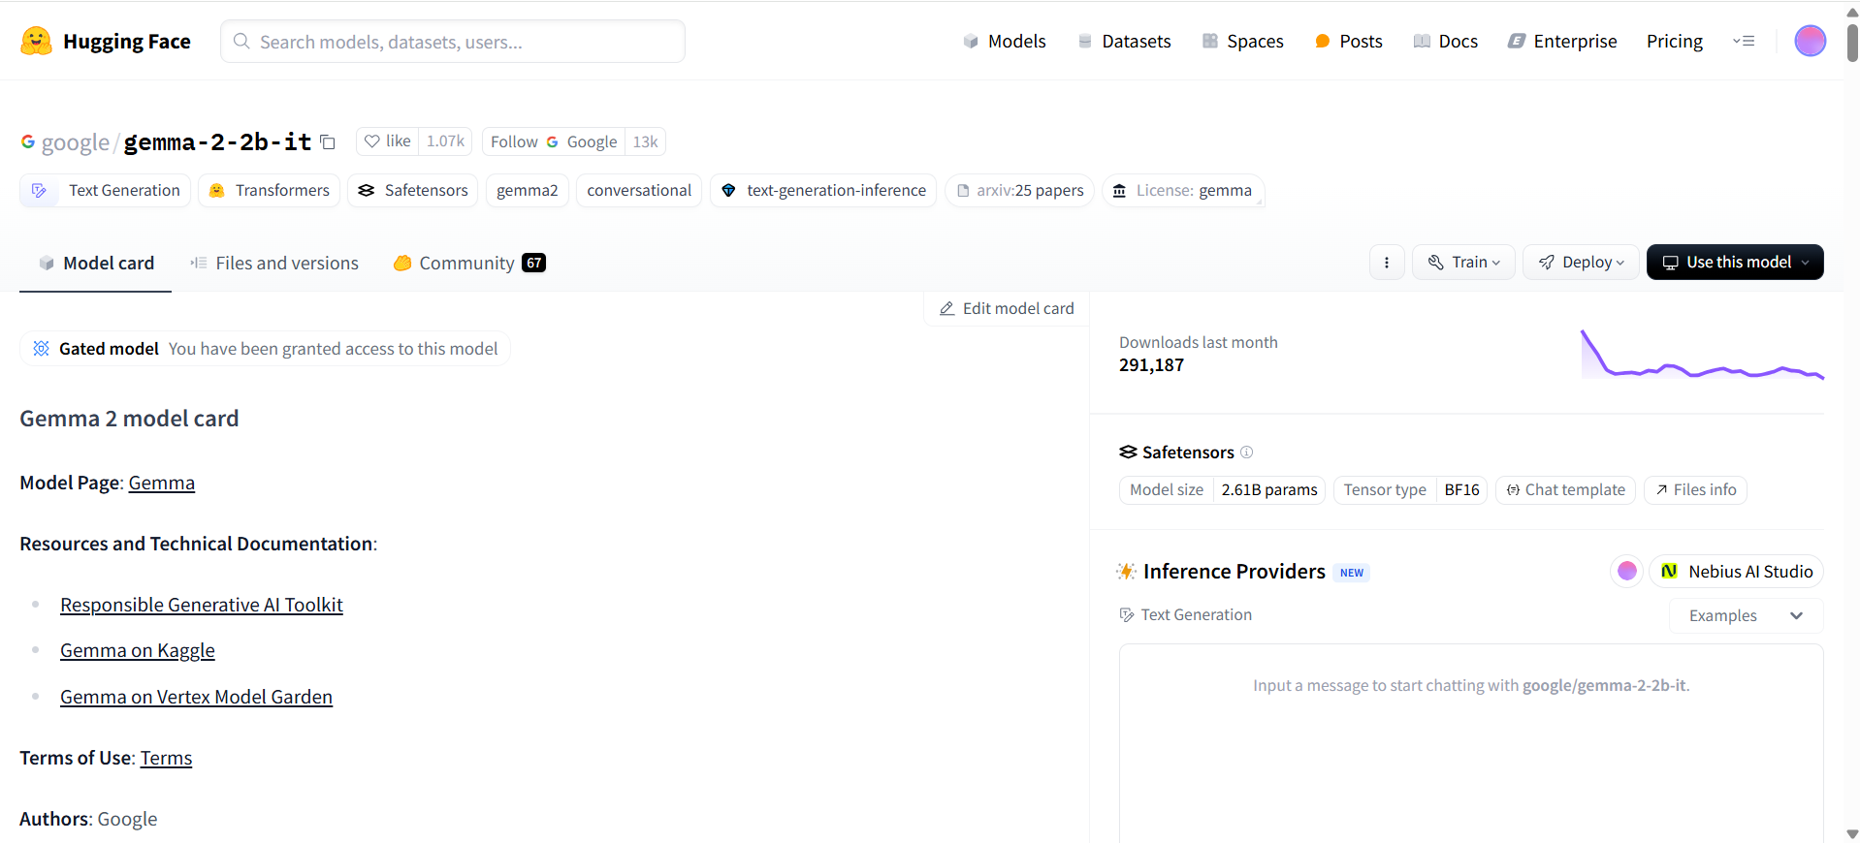
Downloading LLMs
Where to download models: https://huggingface.co/
You can find trending (new) models on the home page
Example of what a model’s Huggingface page looks like

Slide 32
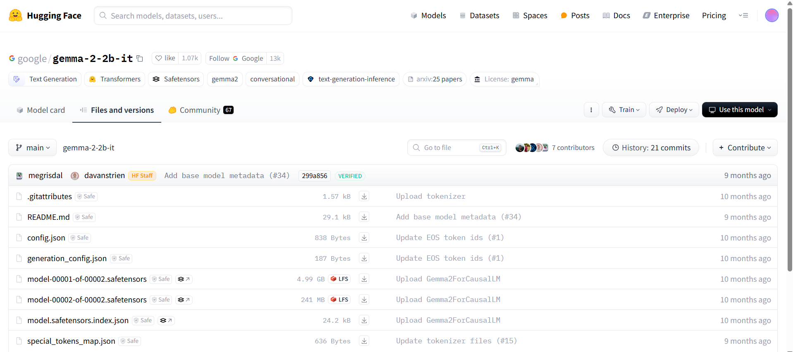
Downloading LLMs (1) – Manual Download

Slide 33
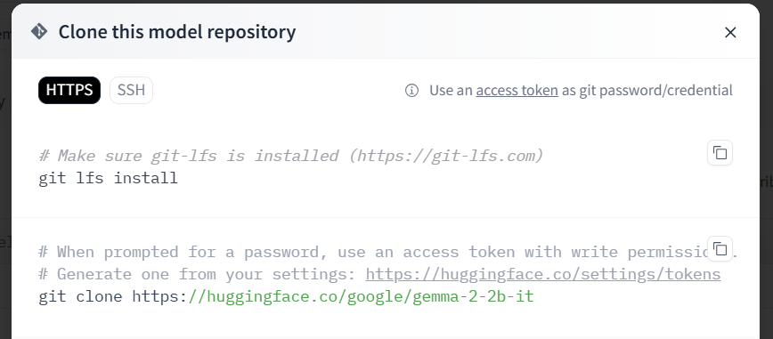
Downloading LLMs (2) - Git

Slide 34
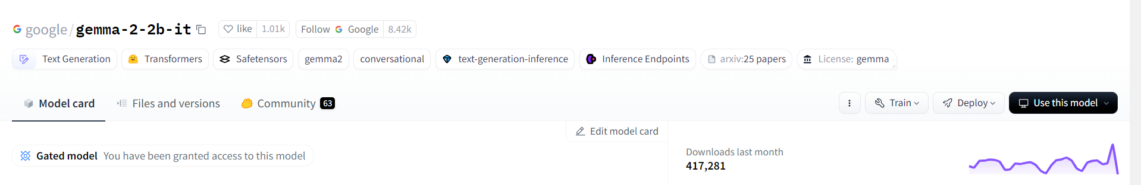
Downloading LLMs (3) – Huggingface/Transformers
google/gemma-2-2b-it
Running models hosted on Huggingface (this will save the models inside the Huggingface library folder):
tokenizer = AutoTokenizer.from_pretrained("google/gemma-2-2b-it", trust_remote_code=True)
model = AutoModelForCausalLM.from_pretrained("google/gemma-2-2b-it", trust_remote_code=True, device_map=0)
Running local/downloaded model:
tokenizer = AutoTokenizer.from_pretrained("/home/sean/Desktop/qlora-main/gemma2-2b-it", trust_remote_code=True)
model = AutoModelForCausalLM.from_pretrained("/home/sean/Desktop/qlora-main/gemma2-2b-it", trust_remote_code=True, device_map=0)

Slide 35
Huggingface Access Tokens
Some models on Huggingface are gated, meaning you need permission to download them
Usually all this entails is accepting their license, some models are gated behind a paywall instead
In such cases, you need to provide your Huggingface account’s access tokens in order to download the model using methods 2 and 3
Manually downloading from the webpage while logged in bypasses the need to provide access tokens

Slide 36
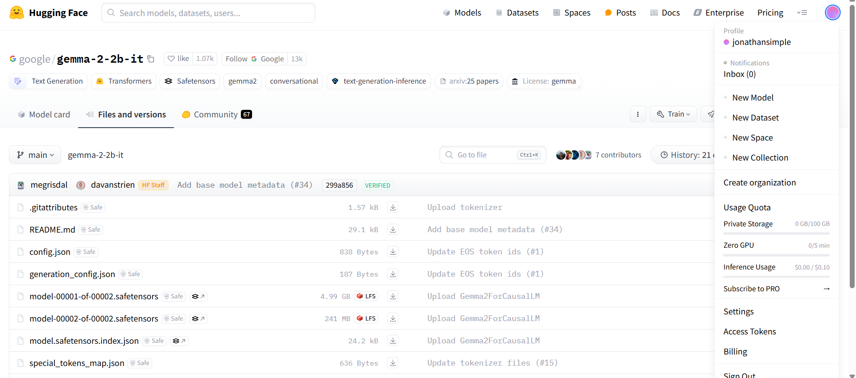
How to Create Your Huggingface Access Tokens
Under account profile, find the “Access Tokens” category (you can also get there via Settings)

Slide 37
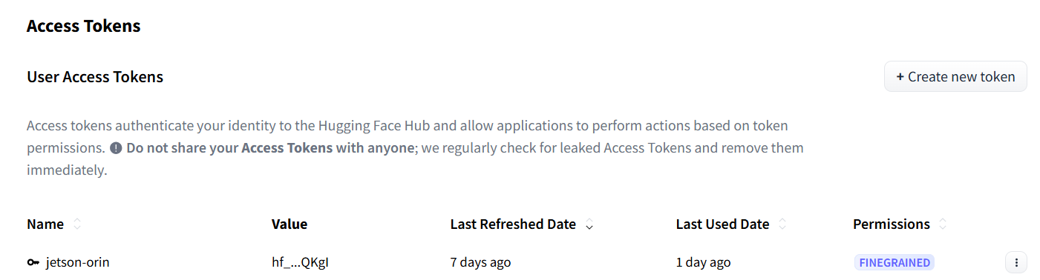
How to Create Your Huggingface Access Tokens
Create your token with the desired read/write privilege and copy it for the next step

Slide 38
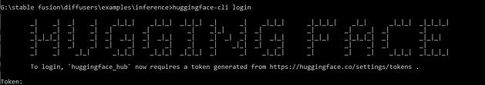
How to Provide Your Huggingface Access Tokens
Method 1: log into huggingface in your conda environment
Install huggingface_hub with command line interface
pip install -U “huggingface_hub[cli]”
Log in using your access token
huggingface-cli login

Slide 39
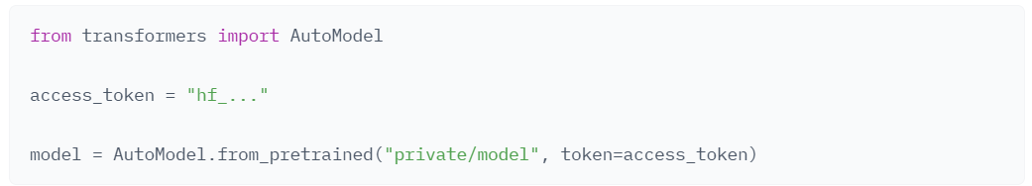
How to Provide Your Huggingface Access Tokens
Method 2: provide your access tokens when you call from_pretrained() [the function that pulls the model]
Notes:
https://huggingface.co/docs/hub/security-tokens

Slide 40
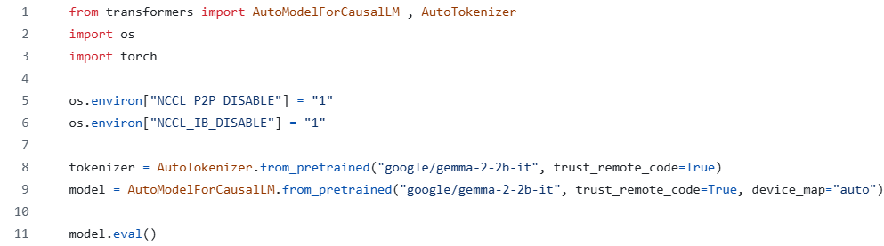
Transformers Example: Imports + Model Loading
If your system doesn’t support P2P GPU communication or InfiniBand (IB), set these environment variables otherwise your program may crash
Replace “google/…” with the path to the folder containing your LLM if you want to load your model + tokenizer from local file
Source code: inference_transformers.py

Slide 41
LLM Deployment Using Transformers

Slide 42
Inferencing with Transformers
Now that we have loaded our model, we can proceed to inferencing
Five main steps:
Generation configuration
Query formatting
Tokenize
Generate/inference
Decode

Slide 43
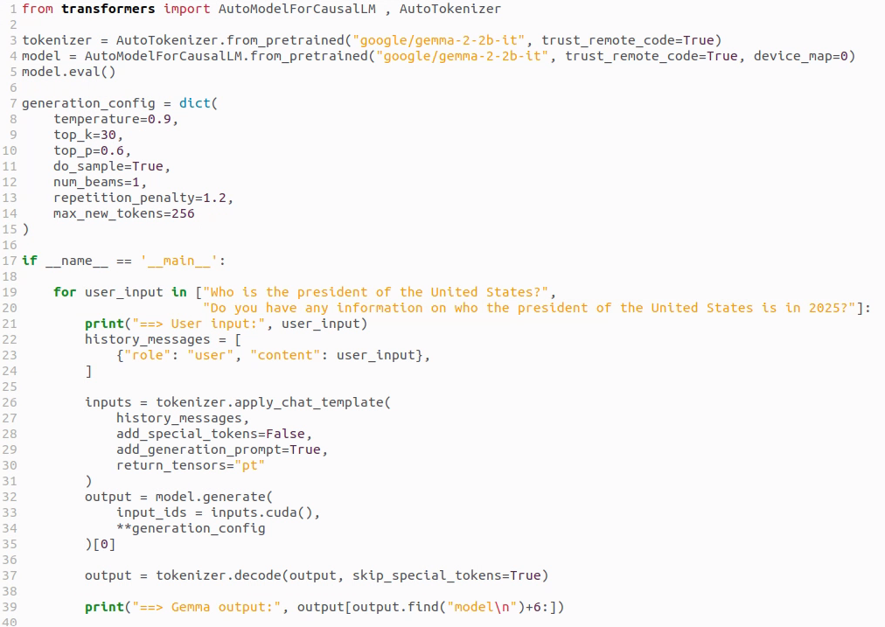
Inference Code Example (modified inference_transformers.py to fit on screen)
1. Set temperature to 0 (or do_sample to False) for deterministic outputs
1. Beam search setting: >1 for less randomness, ==1 for creativity
1. Sets the maximum length of the LLM’s response
2. Generate a new chat session + specify whom (system/user/LLM) this string belongs to
3. Tokenize: convert chat log (string) to tokens
4. Inference step (output is tokens)
5. Convert output tokens to string
Notes:
num_beams controls how many candidate sequences the model keeps track of during beam search decoding.
When to use num_beams
Use beam search (i.e., num_beams > 1) for tasks like:
Summarization
Translation
QA (when deterministic output is better)
When you want higher-quality, less random outputs
Don’t use it when you want:
Randomness/creativity → use do_sample=True instead
If you use num_beams > 1, make sure: do_sample = False
Otherwise the sampling randomness conflicts with beam search logic.

Slide 44
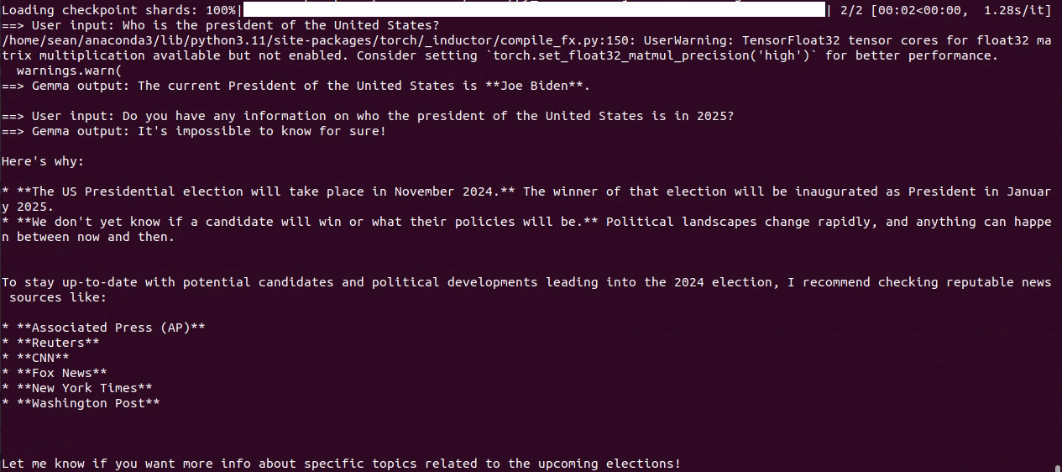
Inference Code Example: Output (inference_transformers.py)
This query exposes the older model’s outdated knowledge base

Slide 45
LLM Deployment Alternatives

Slide 46
LLM Deployment Tools
Feature | Transformers | Ollama | LM Studio
Primary Use | Running, fine-tuning, and deploying LLMs | Local, easy-to-use deployment of LLMs | Local LLMs with GUI-based interaction
User Interface | Python code (CLI/Script-based) | CLI-based, simple for local models | GUI-based, user-friendly for local use
Hardware Requirements | Flexible (depends on model) | Light-weight, works on most systems | Local models (limited by hardware)
Deployment Scale | Small to large-scale (with proper setup) | Small to medium-scale (local use) | Personal or small-scale deployment
Target | Flexibility and ease of use for researchers | Simplicity and accessibility | Simplicity, local deployment
Performance | Slow | Fast | Fast
Out of all the deployment options, transformers is the slowest, transformers is mostly intended for development and not deployment

Slide 47
Ollama
Great tool for hosting LLMs locally
Based on llama.cpp – optimized for speed
Works on Linux, Windows, macOS
Supports a wide variety of models – if you can’t find the model you are looking for, you can import your own model (in GGUF format)
Notes:
Benefits of locally hosting llms

Slide 48
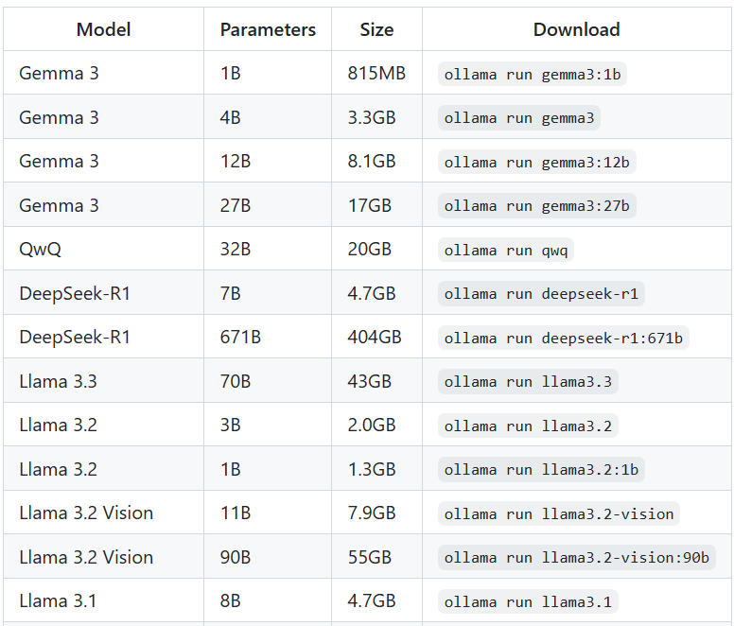
Setting Up Ollama (Linux)
Installation:
curl -fsSL https://ollama.com/install.sh | sh
Downloading a model:
ollama pull gemma3:1b-it-qat
Running a model:
ollama run gemma3:1b-it-qat
Print out all available (downloaded) models
ollama list
A non-exhaustive list of readily available models

Slide 49
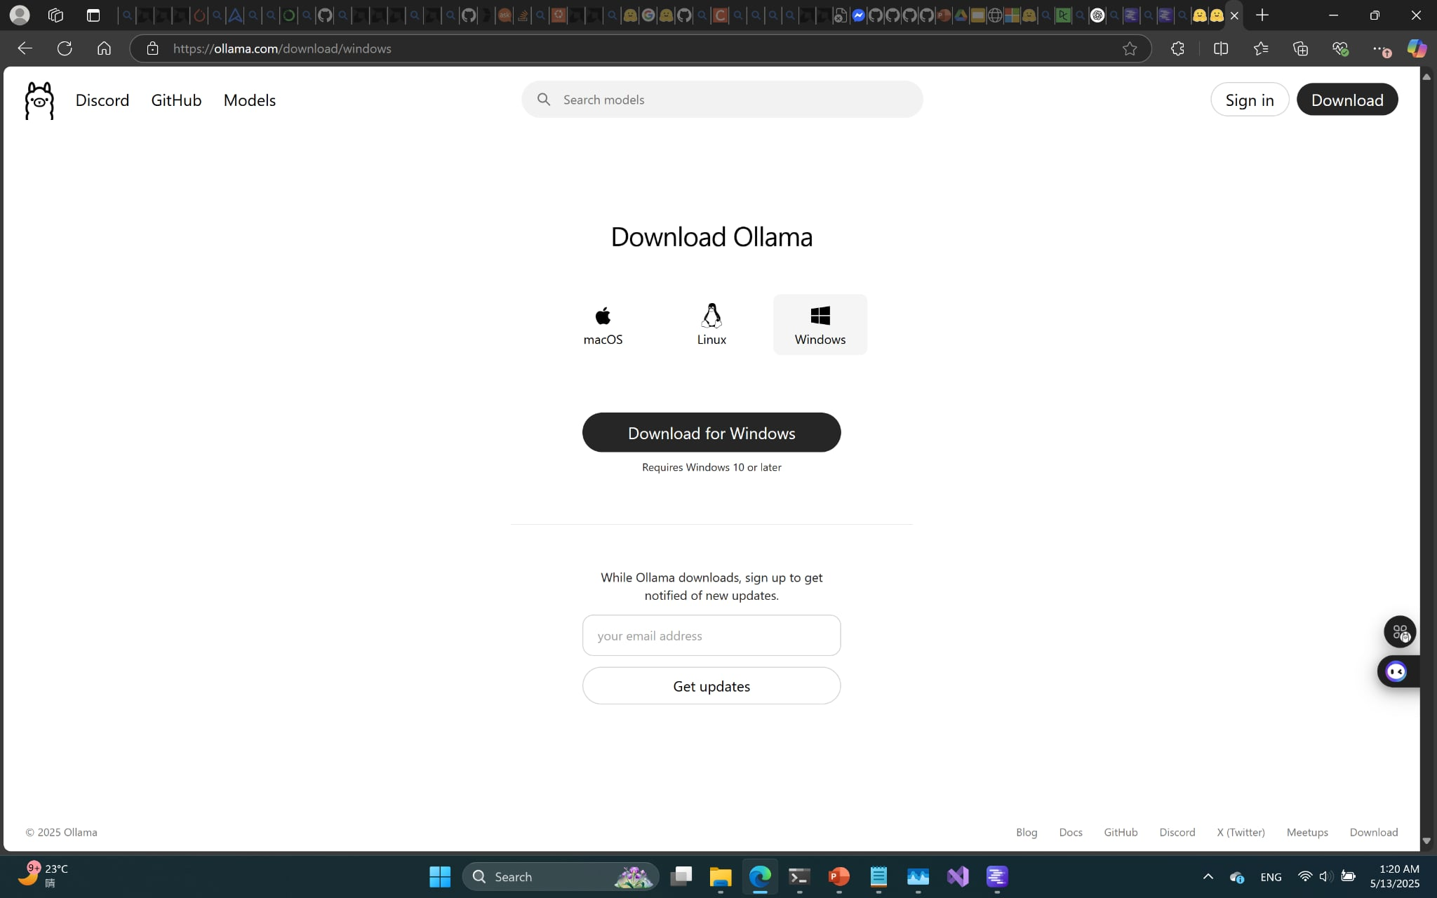
Setting Up Ollama (Windows)
A straightforward installer is available for Windows (simply download and run)

Slide 50
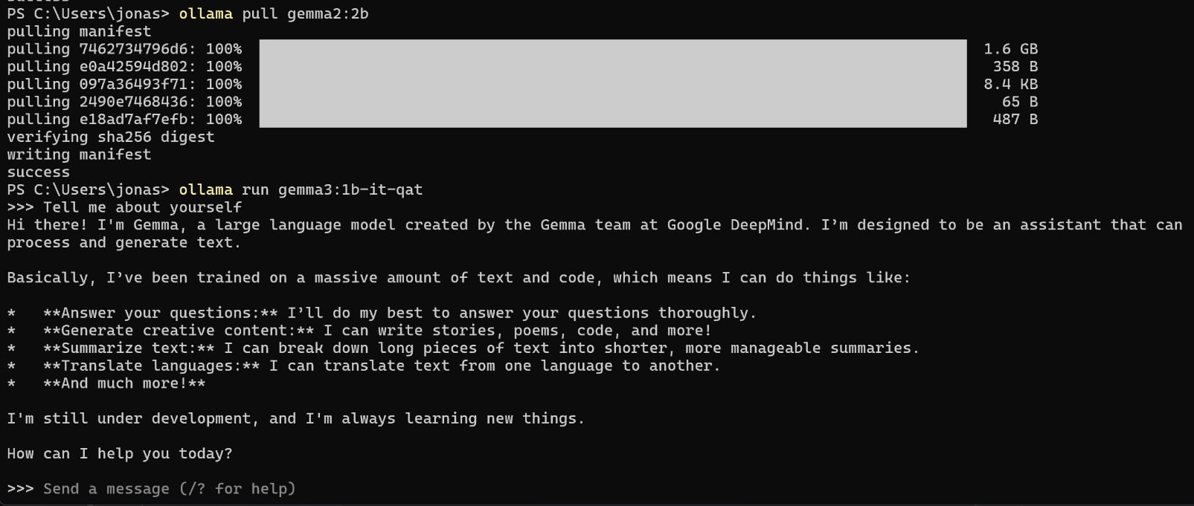
Running Ollama as a Chatbot on Command Line
Use the command: ollama run gemma3:1b-it-qat

Slide 51
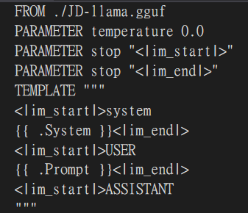
Working With Modelfiles in Ollama (Linux)
With Modelfiles, you can have greater control over the LLM hosted on Ollama
Running your own model:
>>> ollama create mymodel –f modelfile.txt
>>> ollama run mymodel
Quantizing a model:
>>> ollama create --quantize q4_K_M mymodel_q –f modelfile.txt
>>> ollama run mymodel_q
An example of what a Modelfile would look like. The FROM line is mandatory (path to the model)

Slide 52
Using Ollama as a Server
A command line chatbot isn’t very useful, but Ollama can be used as a server to handle query requests
How do we set up an Ollama server?
On your machine’s bootup, Ollama should already be running by default, if not, run ollama serve
What models are available?
All of the model listed when you call ollama list
What is the server’s address?
By default, the Ollama server is posted on http://localhost:11434/v1

Slide 53
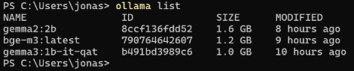
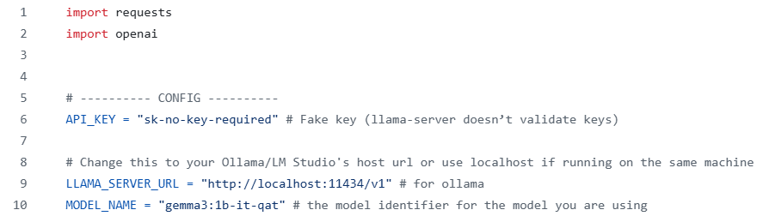
Sending a Query to Your Ollama Server (inference_ollama.py)
List of available LLMs
The model name should match that shown in ollama list

Slide 54
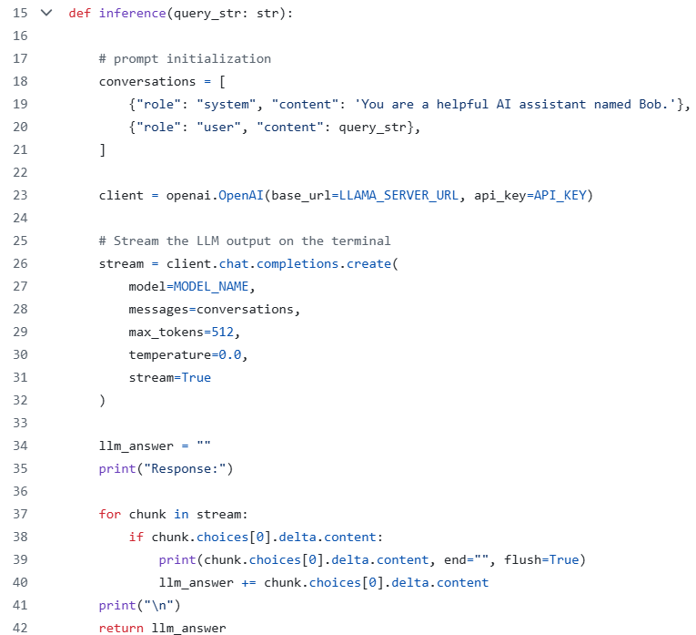
Sending a Query to Your Ollama Server (inference_ollama.py)
Label your query and add any system prompts you wish
Create a client pointing to your Ollama server
The chat completion is where you specify which model you wish to use (notice how you are not explicitly calling tokenizers now, it’s all being done beneath the hood)
Because we set stream=True, the LLM tokens will be streamed to the terminal in real time

Slide 55
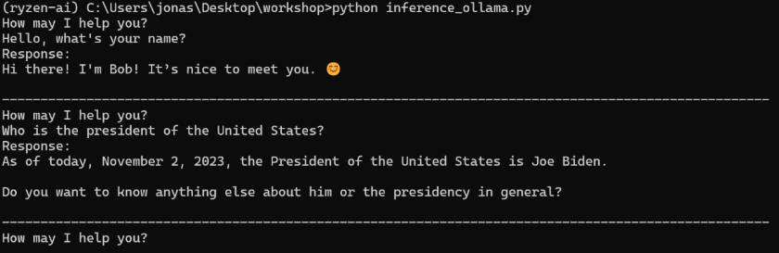
Using Ollama as a Server (inference_ollama.py)

Slide 56
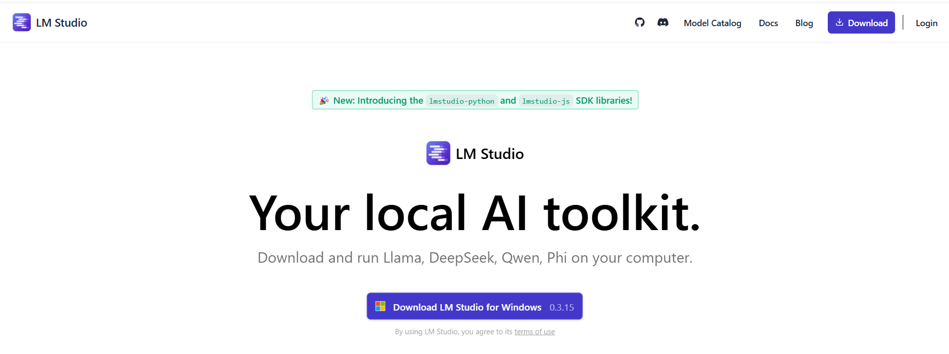
LM Studio (Windows)
LM Studio is another tool for deploying LLMs that comes with a clean GUI
LM Studio also has a lot of interesting stats readily available (token/s, total tokens, token generation termination cause)
Great for beginners

Slide 57
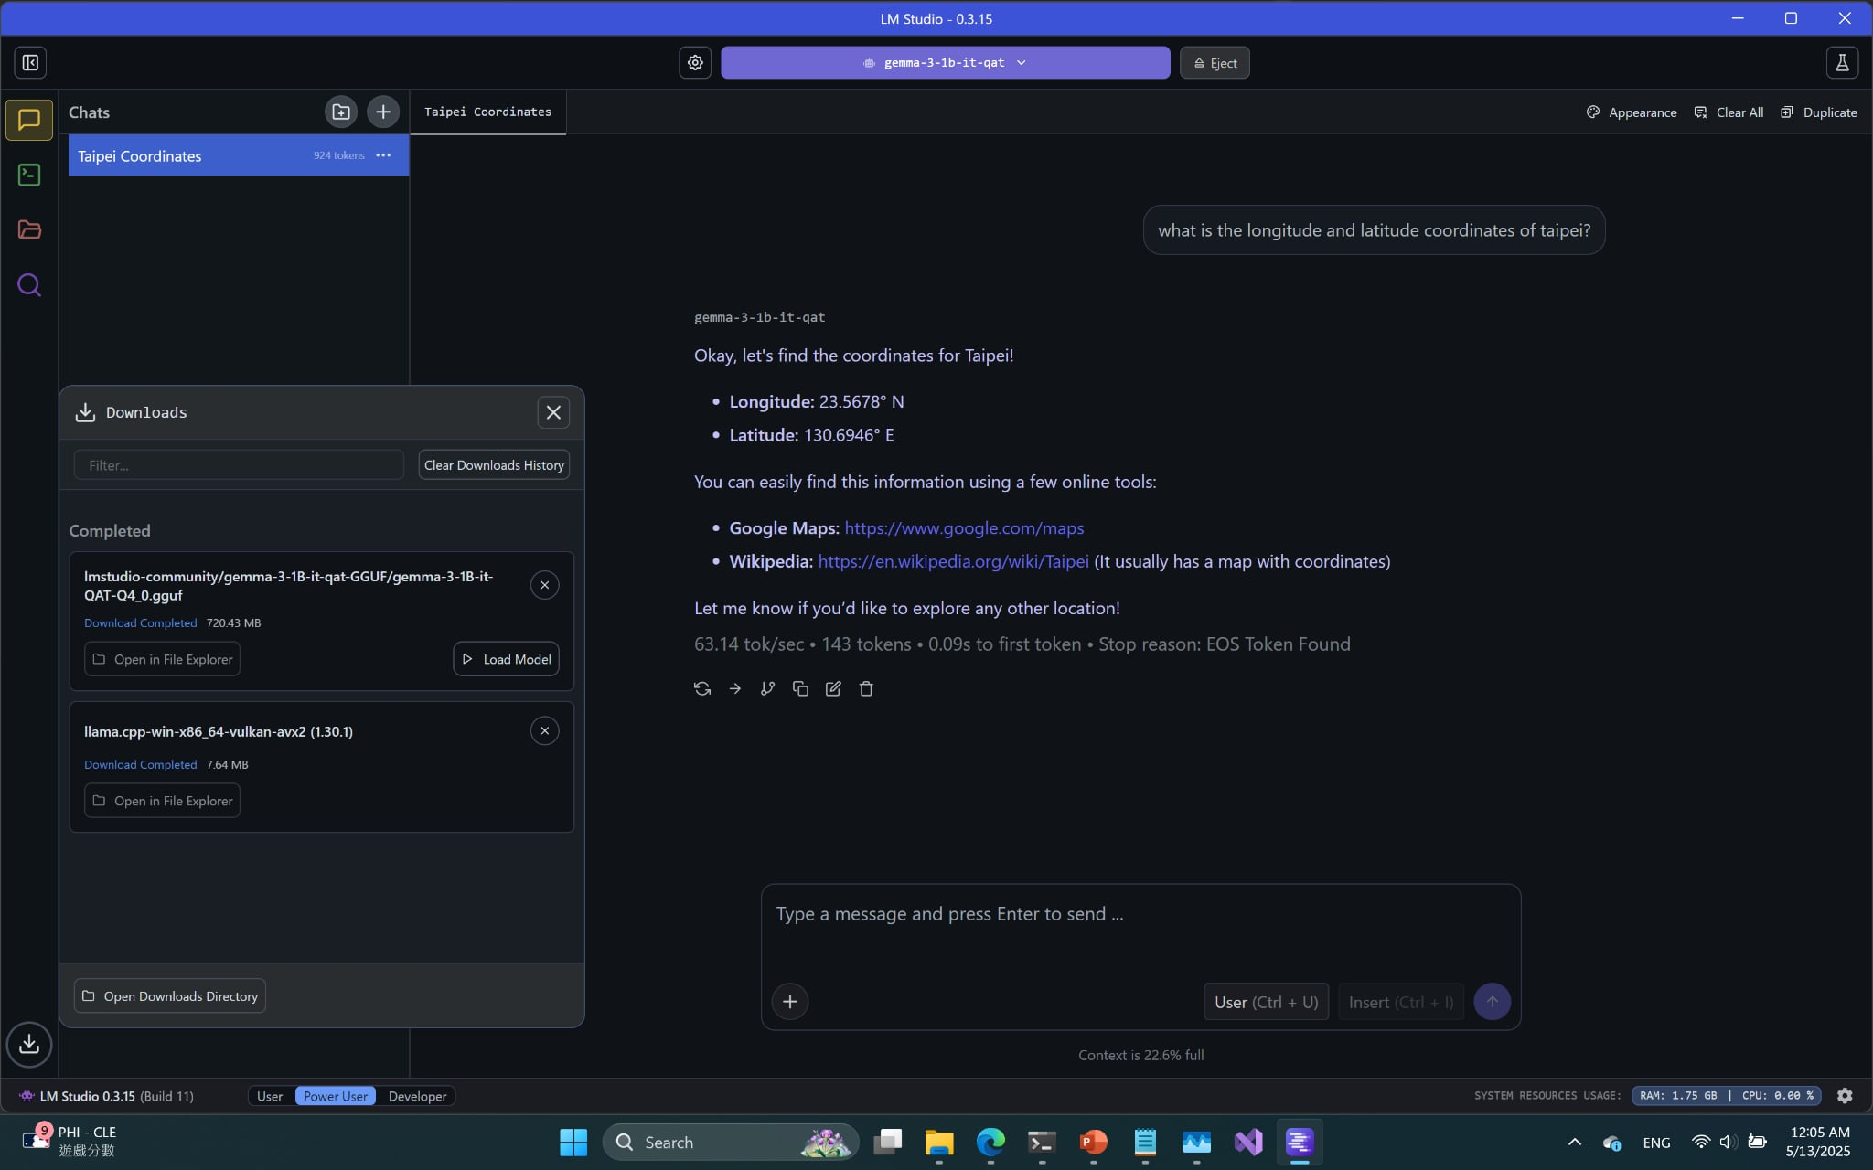
Running LM Studio as a Chatbot (Windows)
Select your desired LLM from the ones you downloaded
Performance metrics

Slide 58
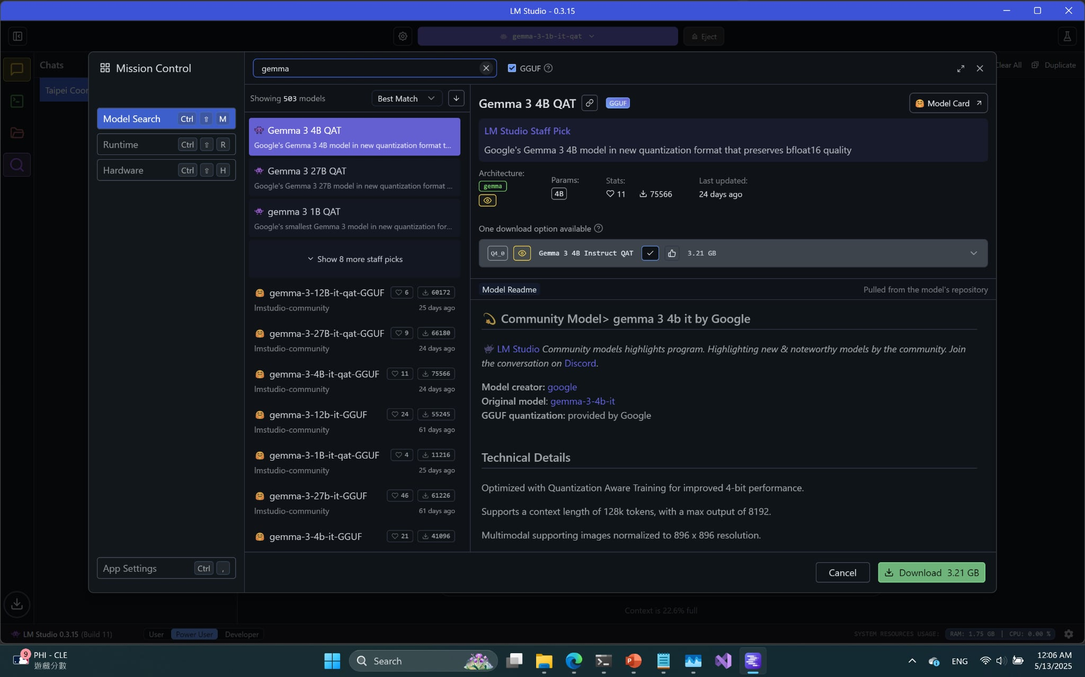
Downloading Models on LM Studio (Windows)
LM Studio can pull models off Hugging Face through the built in search sidebar

Slide 59
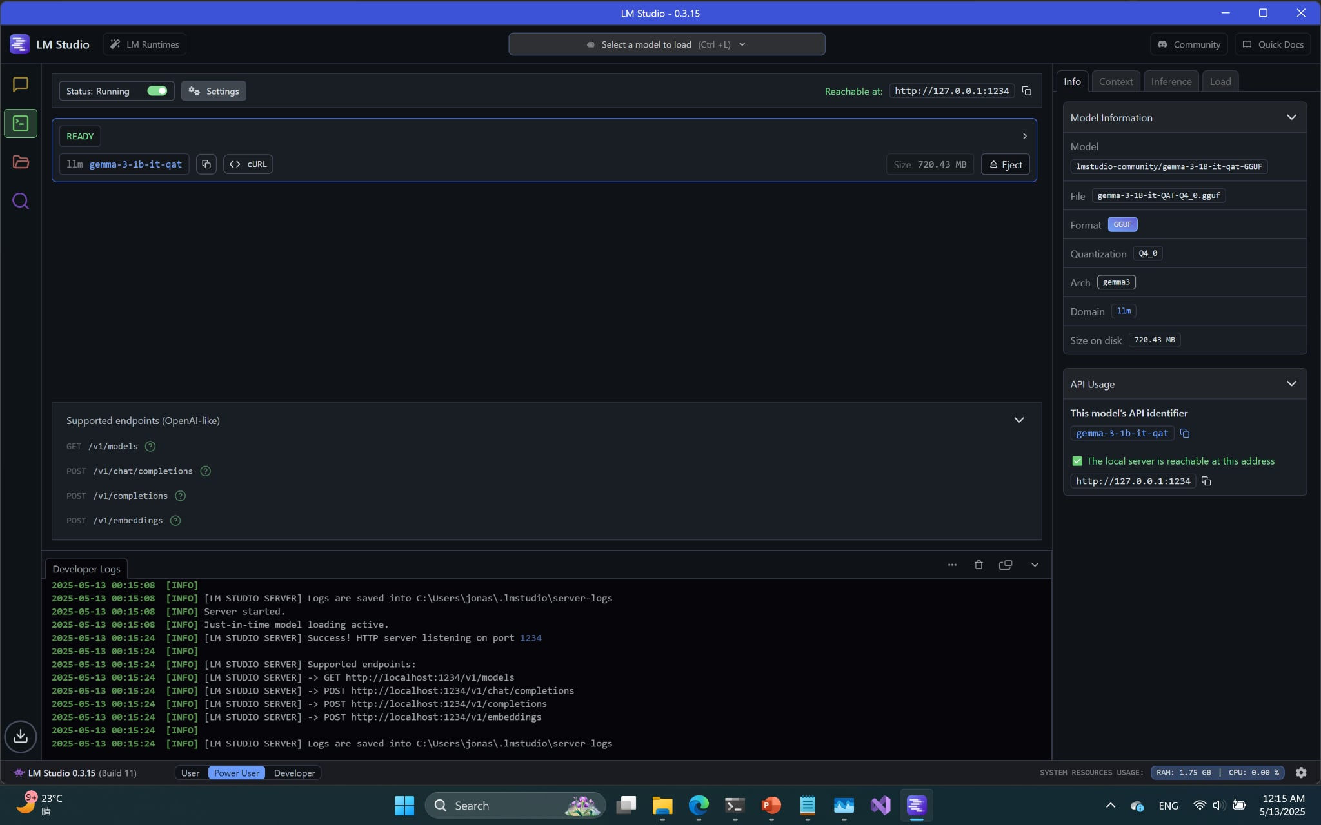
Using LM Studio to Host a Server
Go to the developer tab
A list of downloaded models will appear here

Slide 60
Using LM Studio to Host a Server
Toggle the start server status to start your server (different from Ollama)
Developer Logs and API usage has useful information for setup and debugging

Slide 61
Using LM Studio to Host a Server
Very similar to Ollama (in fact, code is identical, just change server address and model name)
What is the server’s address and model handle?
Check the API Usage sidebar for the server url and the model handle

Slide 62
RAG Using Ollama and LM Studio

Slide 63
Problem Rehash
Why RAG?
Some models have outdated information, but we don't want to find tune the model
Difference between RAG and normal inference:
Additional context for generation is provided (normally you only have the query)
As a result, your prompt will look different
Here is a very simple RAG prompt:
Context: Donald Trump won the 2024 presidential election and remains president in 2025. Most new models can perform function calling out-of-the-box.
Question: Who is the president of the United States in 2025?
Answer:

Slide 64
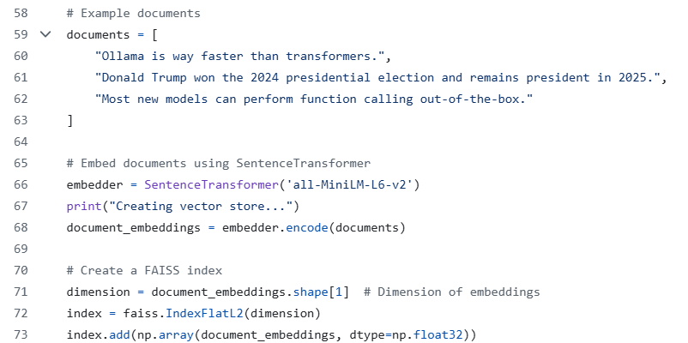
Building a Vector Store for Retrieving Relevant Context (rag_query_ollama.py)
One of many examples of building a vector store using FAISS

Slide 65
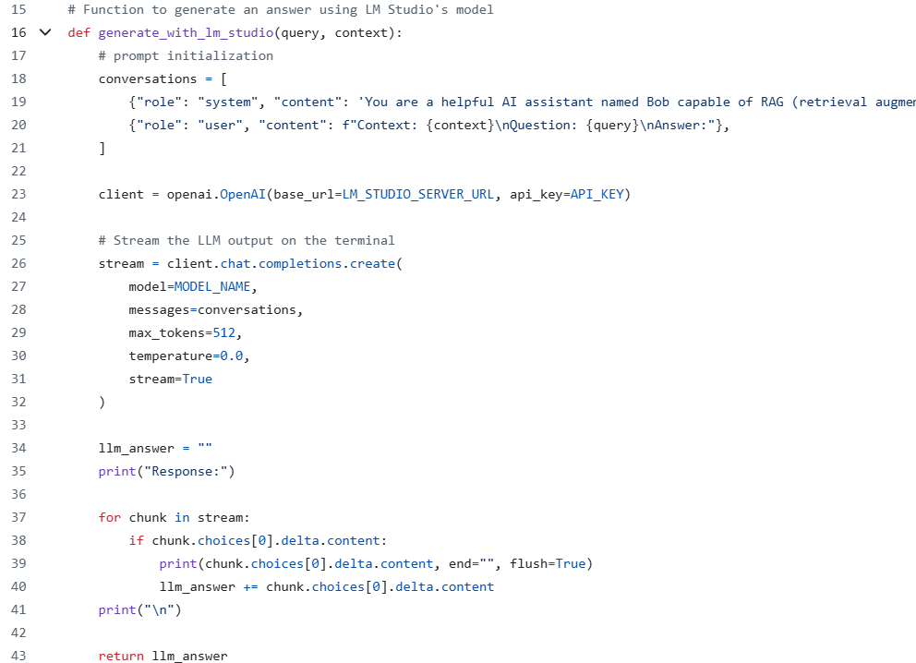
Generating a Response using LM Studio (rag_query_ollama.py)
Very similar to the Ollama client code, the only difference here is that the system prompt and user prompt have been modified to be more RAG friendly.

Slide 66
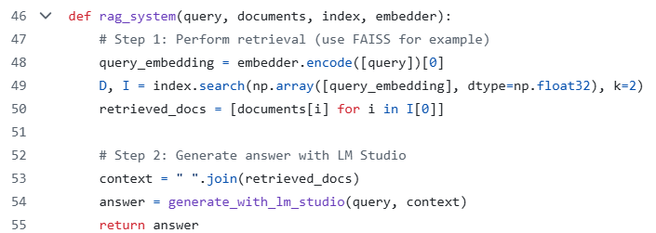
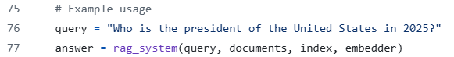
Putting Everything Together (rag_query_ollama.py)
Find the top 2 documents that most closely relate to the query
Concat the retrieved contexts for the RAG prompt
End-to-end function call

Slide 67
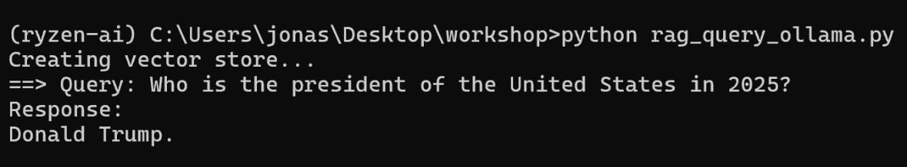
RAG Using Ollama and LM Studio (rag_query_ollama.py)

Slide 68
Fine Tuning with LoRA

Slide 69
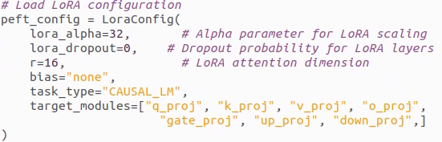
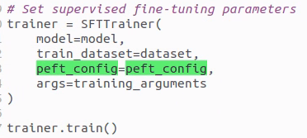
How to Set Up LoRA Fine Tuning
You’ll need to install the peft library
You can tune your LoRA hyperparameters using peft’s LoraConfig()
During training, you pass this config to the trainer

Slide 70
LoRA Hyperparameters
For those just getting started with LoRA, focus on the r (rank) and alpha parameters
If you run into CUDA OOM (out of memory) problems and you can’t reduce your batch size or max input length any further, you can try reducing the rank
When starting out, it is recommended to maintain a 1:2 ratio between rank and alpha

Slide 71
Other Hyperparameters
The trainer used for this demo comes from transformers’ trl library (specifically SFTTrainer and SFTConfig)
Here are some noteworthy parameters to tune while training your model:
max_seq_length: how many tokens your model can take in at once, affects your LLM’s ability to handle long inputs; drastically affects VRAM usage
per_device_train_batch_size: batch size, adjust this based on your VRAM
save_strategy: how often you save checkpoints
num_train_epochs: how many epochs to train for (you can also opt to use steps as a unit instead of epoch)
learning_rate
bf16: whether to train in bf16
logging_steps: how often you log training statistics

Slide 72
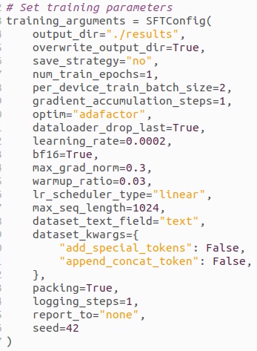

Example SFTConfig
See gemma_function_calling_finetune.py for a short example that you can run with a custom function calling dataset inside the ./dataset folder

Slide 73

How to Full Fine Tune a Model (Transformers)
Full code available on gemma_function_calling_full_finetune.py

Slide 74
Other Fine Tuning Frameworks
For more advanced full fine tuning/LoRA implementations, consider surveying the following papers and their associated repos:
Unsloth
Xtuner
BELLE
These only work on Nvidia hardware
For ROCm based solutions, stick to transformers, pytorch, deepspeed implementations
While not exclusively related to fine tuning, it would also be useful to familiarize yourself with flash attention

Slide 75

Unsloth
https://github.com/unslothai/unsloth
Supports full-finetuning on NVIDIA GPUs and Intel GPUs only

Slide 76
Conclusion
In this course, we discussed:
The basics of LLMs and how they work
How to improve a LLM’s performance with and without fine tuning (RAG)
How to set up and deploy basic LLM programs on AMD platforms

Slide 77
Introduction to Function Calling: Overview

Slide 78




Tools/Function Calling
Objective: using the semantic understanding of large language models (LLMs), convert a user’s unstructured command into control signals for other applications with function calling
For LLMs, function calling refers to when the LLM infers the correct function to call and its input parameters from the user prompt
Applications: IoT, search (retrieve real-time data online or from local database), automated customer service (banking, booking), AI PC
Take two steps forward
[00 01 11 00]
Controller
Whisper
Gemma 2 2B
API
Speech to text
Decide which function to use and convert text to JSON
Using JSON data fields as input, call function
Spoken command as input
{“function”: “perform_action”, “action”: “walk forward, …”}
Perform action

Slide 79
Speeding Up Your Projects: Speculative Decoding

Slide 80
Speculative Decoding
Objective: speed up LLM token generation by guessing the next token
Examples: EAGLE, MEDUSA, Lookahead, speculative sampling

Slide 81

EAGLE (Extrapolation Algorithm for Greater Language-model Efficiency)
Goal: if f1 generates t2 and f2 generates t3, estimate f3 so we can predict t4
Given: t1→f1 →t2, t2 →f2 →t3, predict t3 →f3 →t4
How to get f3: pass t3 through the embedding and transformer layer (slow)
EAGLE head
How to speed up this process: use lightweight EAGLE auto-regression layer to estimate f3

Slide 82

Speculative Decoding Example
Load model + tokenizer + EAGLE head from local file

Slide 83

Inferencing With and Without EAGLE

